Slide 1

TOPIC:
Smart Mart
Team Name: Code Warrior’s

Slide 2
TEAM MEMBERS:
Salvader Ron Nathaniel (PIET19CS144)
Shruti Choudhary (PIET19CS160)
Shubham Tambi (PIET19CS164)
Shreya Jain(PIET19CS157)

Slide 3
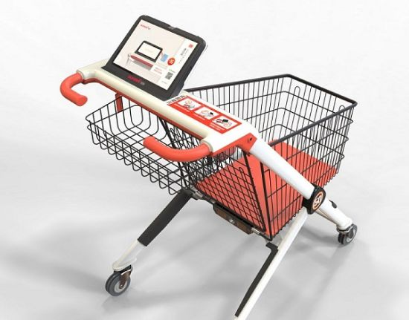
About Project
This Project is aimed at reducing the Queues which are usually seen on the Billing Counters of Shopping Marts through a system that will enable customers to choose what they want to buy and the total cost of products they are going to purchase this in turn will improve the customer experience in the Shopping Marts and reduce billing Queues as the data will be pre-available with the customer executives

Slide 4

Tech-Stack
The Project will be made using Hypertext Markup Language, Cascading Style Sheet ,JavaScript, Structured Query Language and many other technologies
And, Will be implemented via either Apache Web Server (on Linux Platform) , Sockets or Cloud

Slide 5
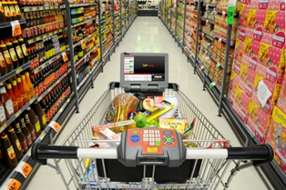
Relevance to Society and Self
The Project is Relevant in the following ways:
This helps to reduce the large queue during the shopping.
It can save time for both the buyer and the retailer.
It forwards us towards the digital world.

Slide 6
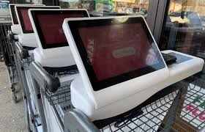
Relevance to technical world
Applications streamline interactions between people and services, enhancing customer experience.
It reduces the manual work.
It directs the world towards digitalization.

Slide 7
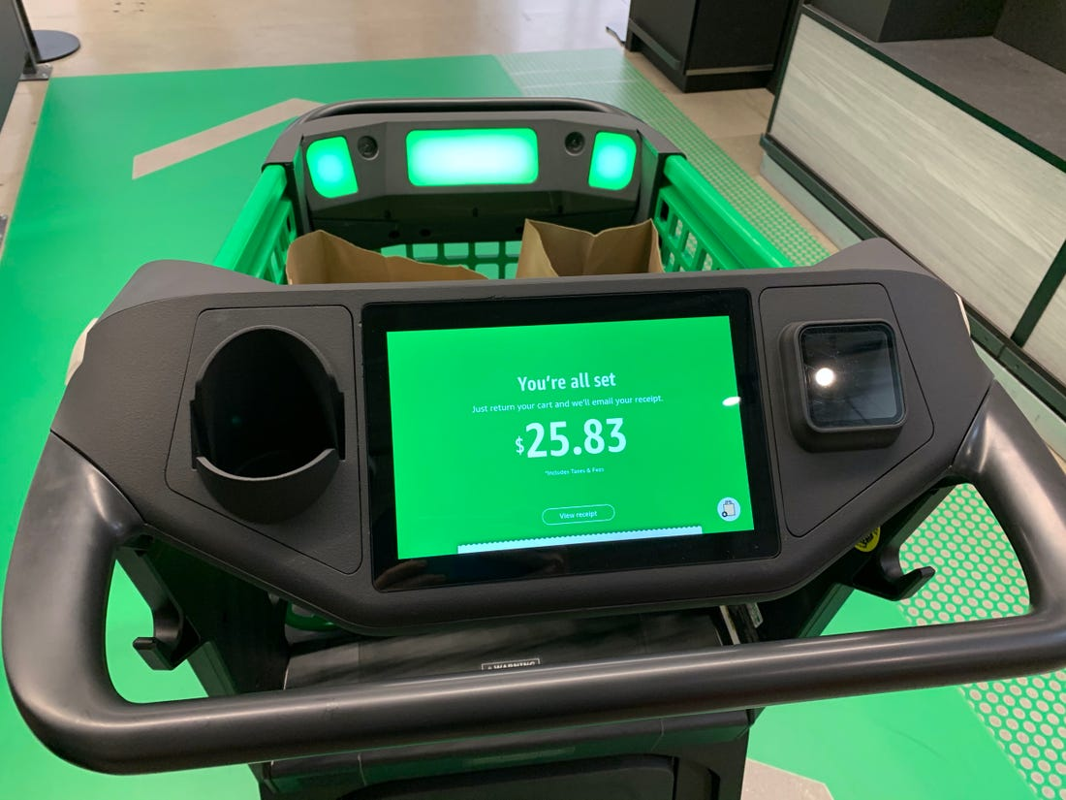
Future Developments
Some of the Future Developments for the Project are:
Providing the facility of booking orders for pickup within 2 hours
Implementing a barcode reader so as to autodetect the item placed in the cart which can further be improvised by using image-processing and deep learning techniques
Transforming the webapp into a Android application

Slide 8
THANKYOU

